Slide 1
Philippians 1:1-11
Ode to Joy
Hawthorn Church of Christ, 4 October 2020

Slide 2
Philippians 1:1-11
Secret to Joy:
Hawthorn Church of Christ, 4 October 2020

Slide 3
Philippians 1:1-11
Secret to Joy:
Sold out for Jesus
Hawthorn Church of Christ, 4 October 2020

Slide 4
Philippians 1:1-11
Secret to Joy:
Sold out for Jesus
Living to bless others
Hawthorn Church of Christ, 4 October 2020

Slide 5
Philippians 1:1-11
Secret to Joy:
Sold out for Jesus
Living to bless others
Thankful – focused on the positive
Hawthorn Church of Christ, 4 October 2020

Slide 6
Philippians 1:1-11
Secret to Joy:
Sold out for Jesus
Living to bless others
Thankful – focused on the positive
Prayerful
Hawthorn Church of Christ, 4 October 2020

Slide 7
Philippians 1:1-11
Secret to Joy:
Sold out for Jesus
Living to bless others
Thankful – focused on the positive
Prayerful
Not alone – in partnership
Hawthorn Church of Christ, 4 October 2020

Slide 8
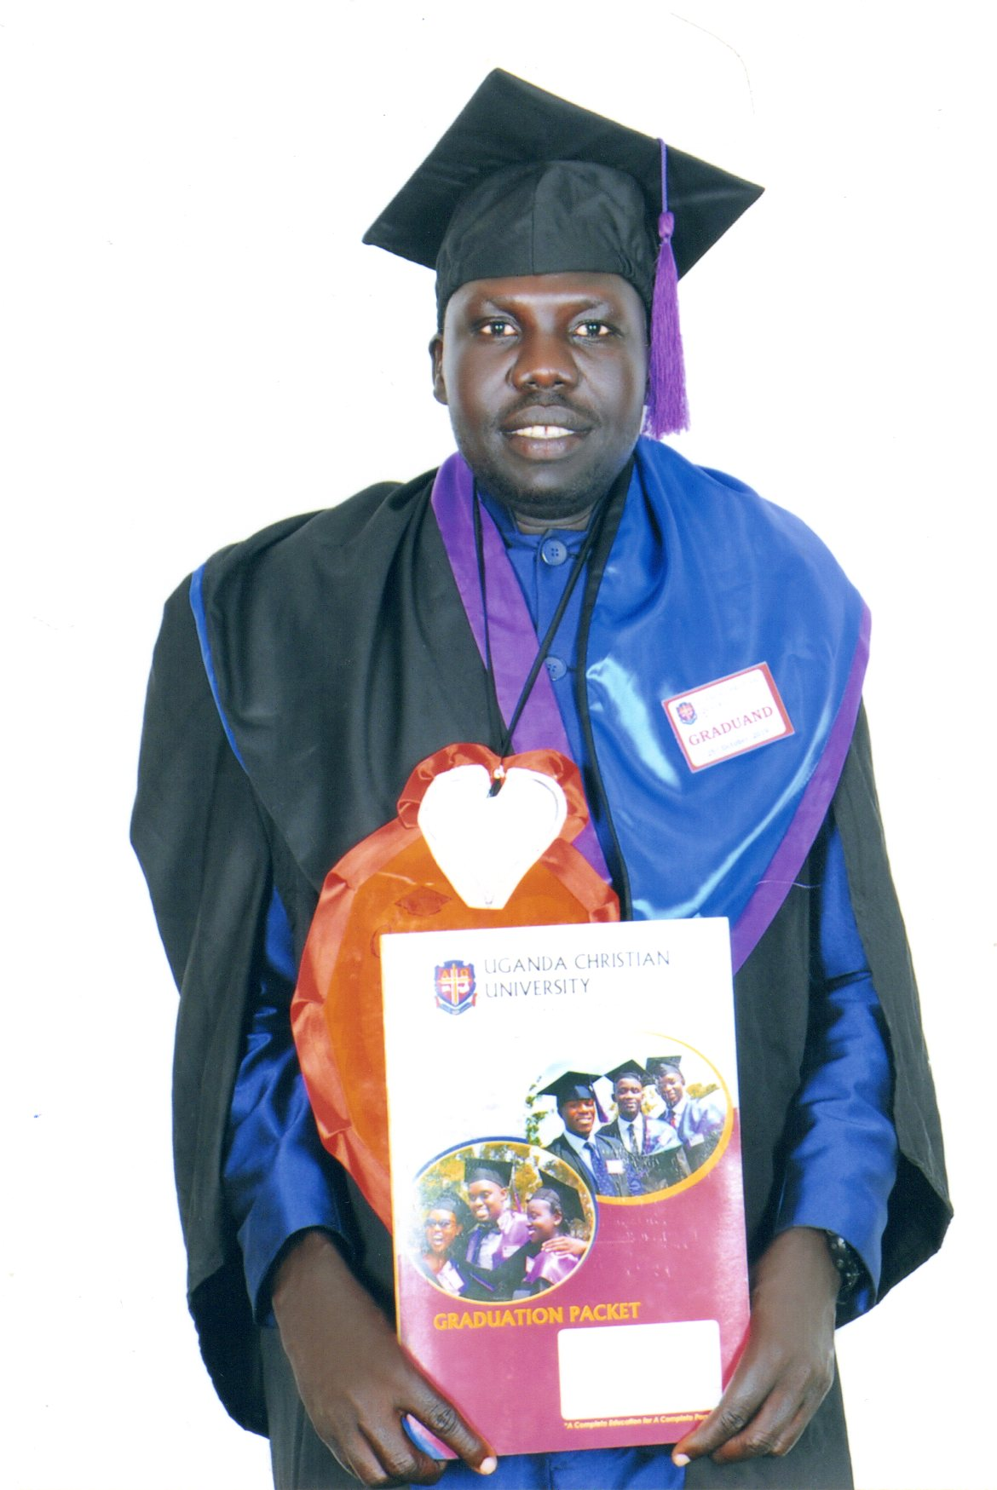
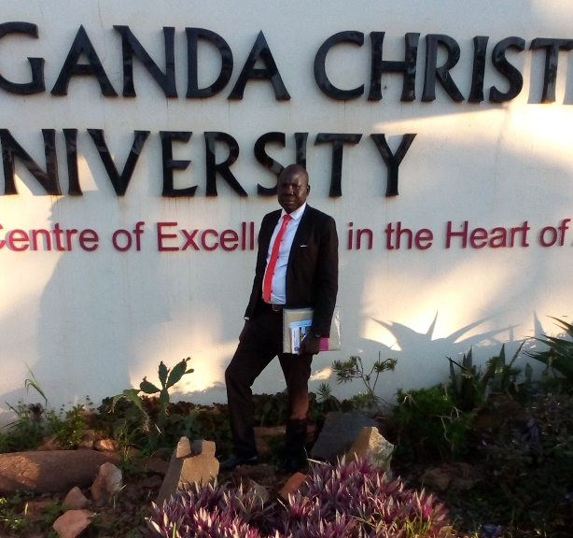
Paulino Malou (Christian Mercy International), South Sudan

Slide 9
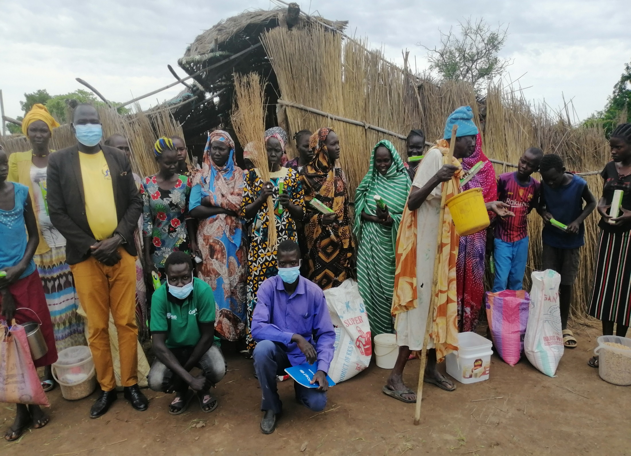
COVID-19
Apada Community South Sudan

Slide 10
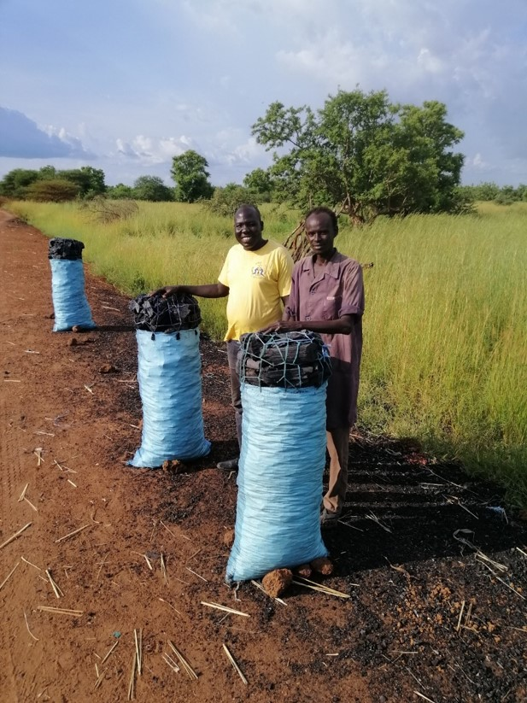
Charcoal Sellers

Slide 11
Emmanuel School

Slide 14
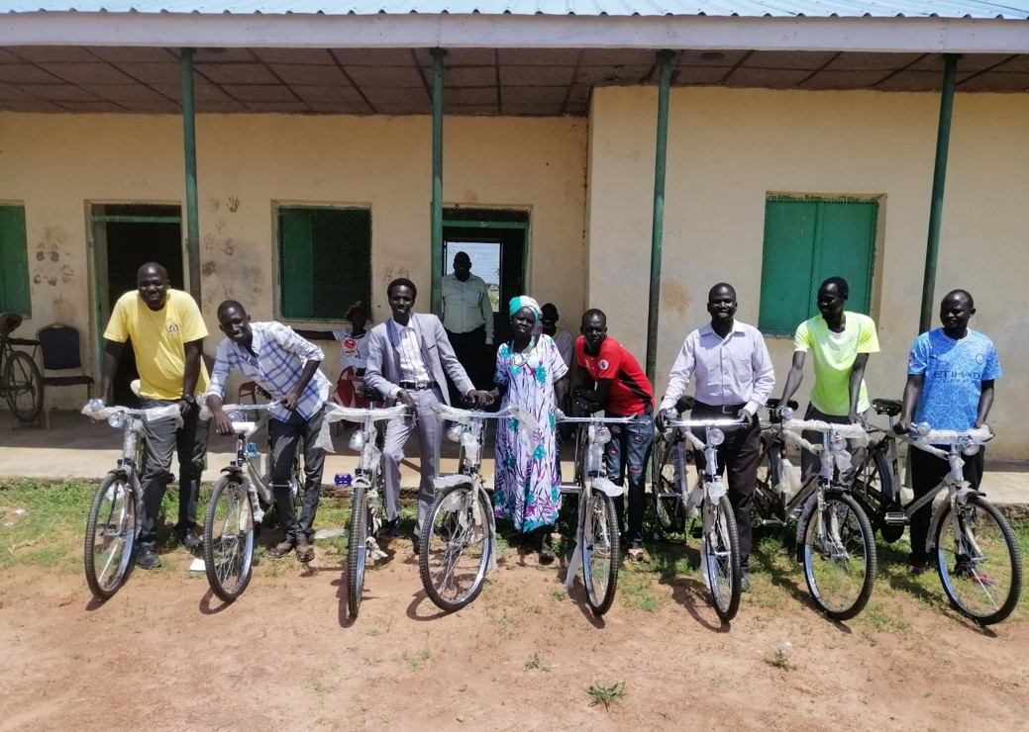
Staff at Emmanuel School

Slide 15
Goats Project

Slide 16
Khayelihle Children’s Village, Zimbabwe
Studying in the Library

Slide 17
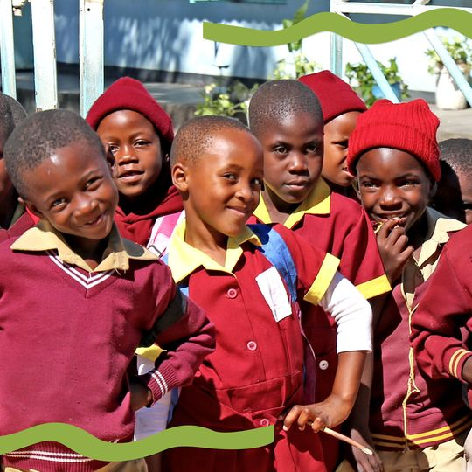
End of October school returns

Slide 18
Hosanna Ministries, India
Danny Gaikwad delivering food in the Mumbai slums

Slide 19
Tailoring Course

Slide 20
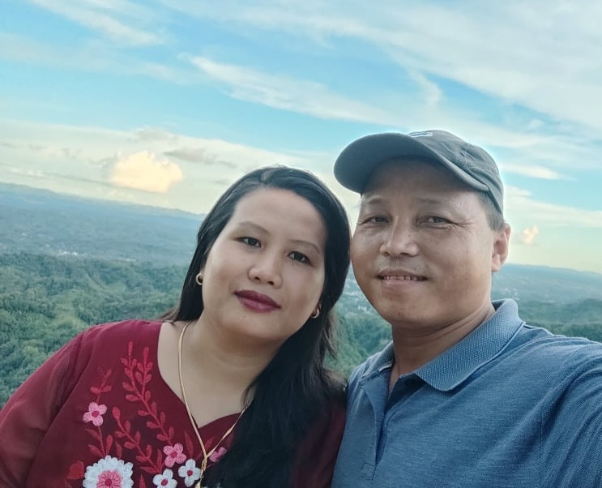
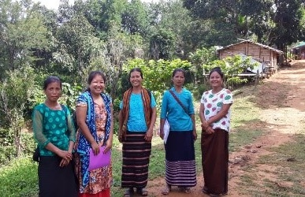
Singermoi and Vana Bawm
COVID Response,
Bangladesh
Food and hygiene kits providing support to 650 households in Ruma and Rwangchary.
(Selection is based on need.)
This support is in the provision of: masks, rice, soap, salt, oil, dal, and a gunny bag.

Slide 21
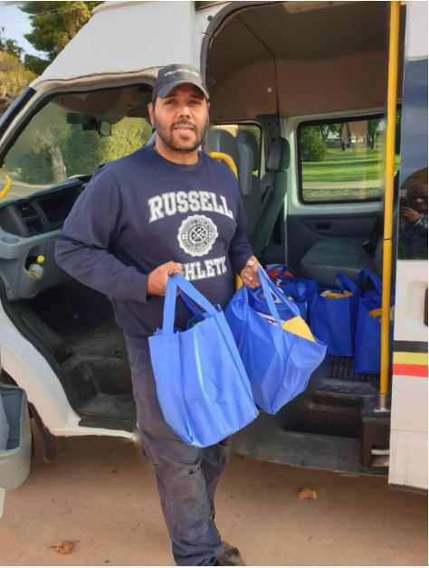
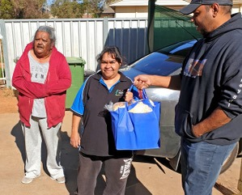
Essentials Pack Delivery

Slide 22
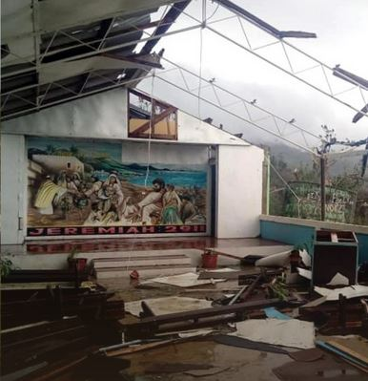
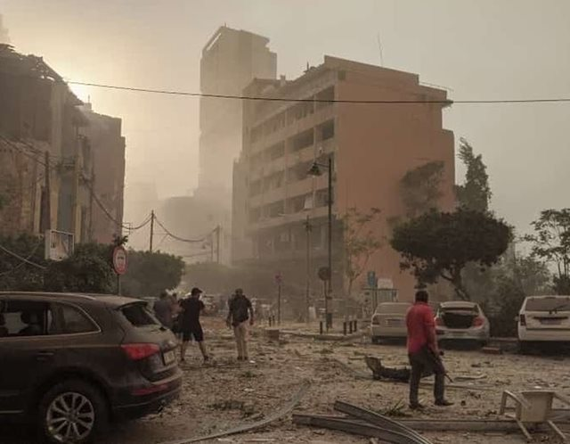
Emergency Appeals – Vanuatu & Lebanon
Cyclone Harold, April 2020
Beirut Explosion, August 2020

Slide 23
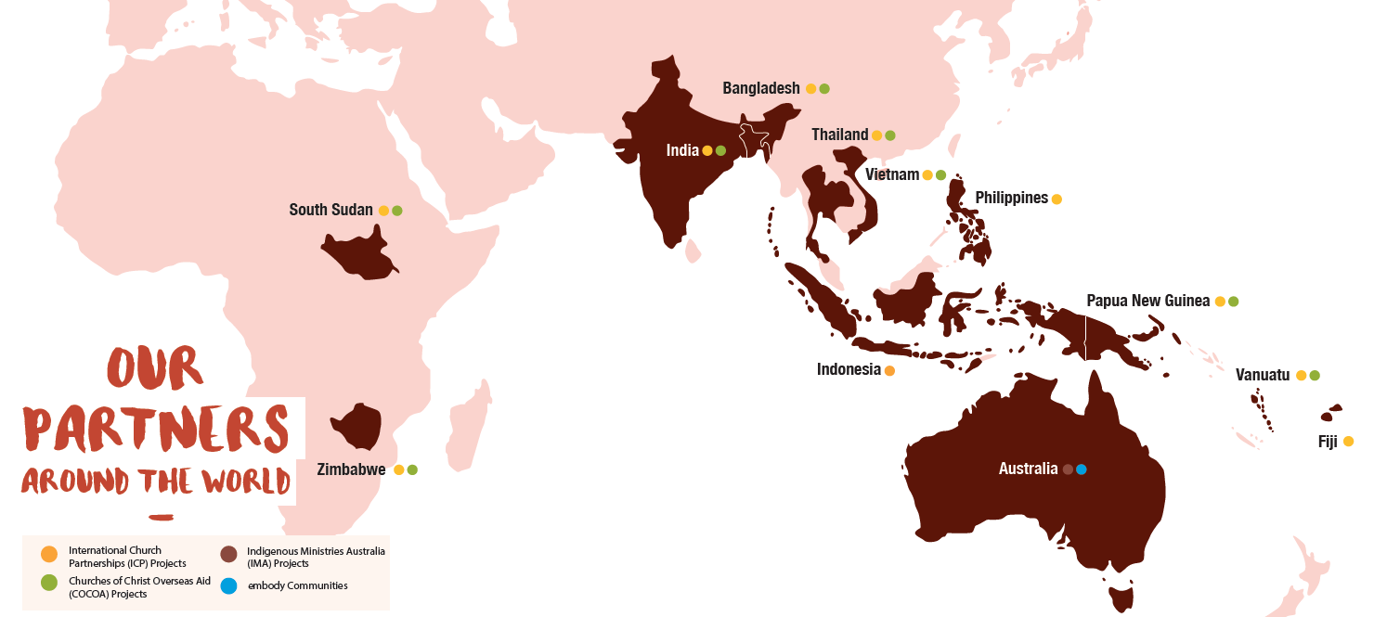
Australian Churches of Christ Global Mission Partners
Notes:
Joins churches of Christ across Australia together.
You are an owner through Fresh Hope.
Affinity with partners.
Four colours – four things going on

Slide 24
Holistic Mission – Word and Deed – Here and There
Notes:
Evangelism, Church Planting and Training – Proclamation
Community Development – water, education and livelihoods – Demonstration
Indigenous Ministries Australia – Church and Community amongst Indigenous people
Embody – young people
Emergencies – TC Harold, Covid
Only one other in Australia with this breadth
One stop shop

Slide 25
International Church Partnerships
International Christian College of Manila, Philippines

Slide 26
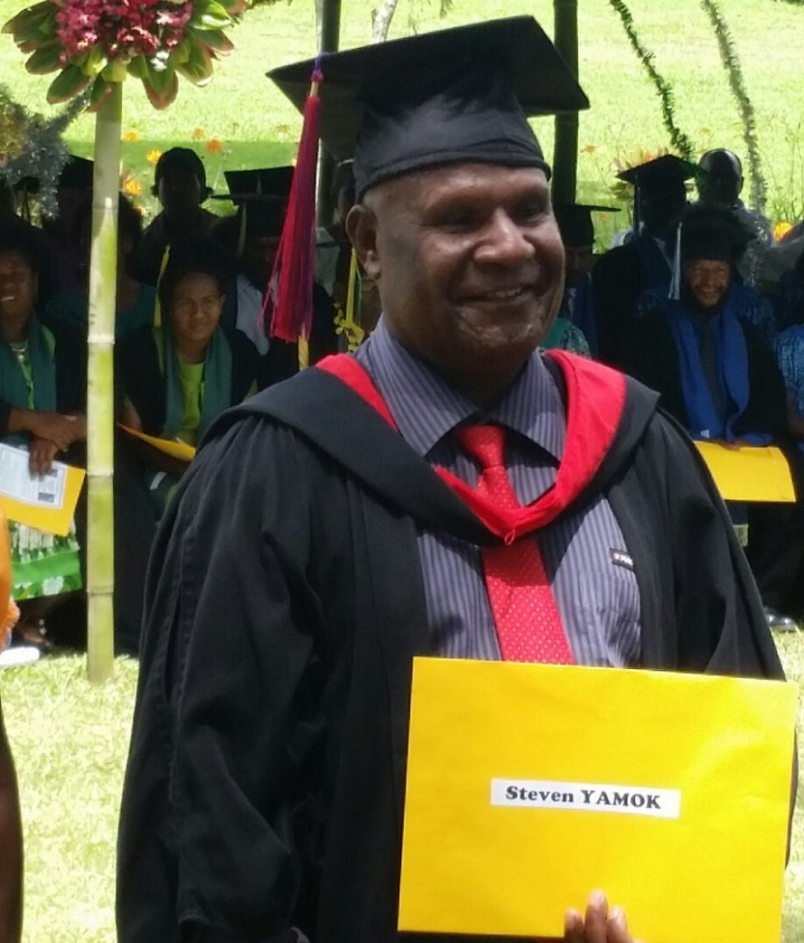
Gandep Bible College, PNG
Principal Steven Yamok and Lecturer Caleb Dankro

Slide 27
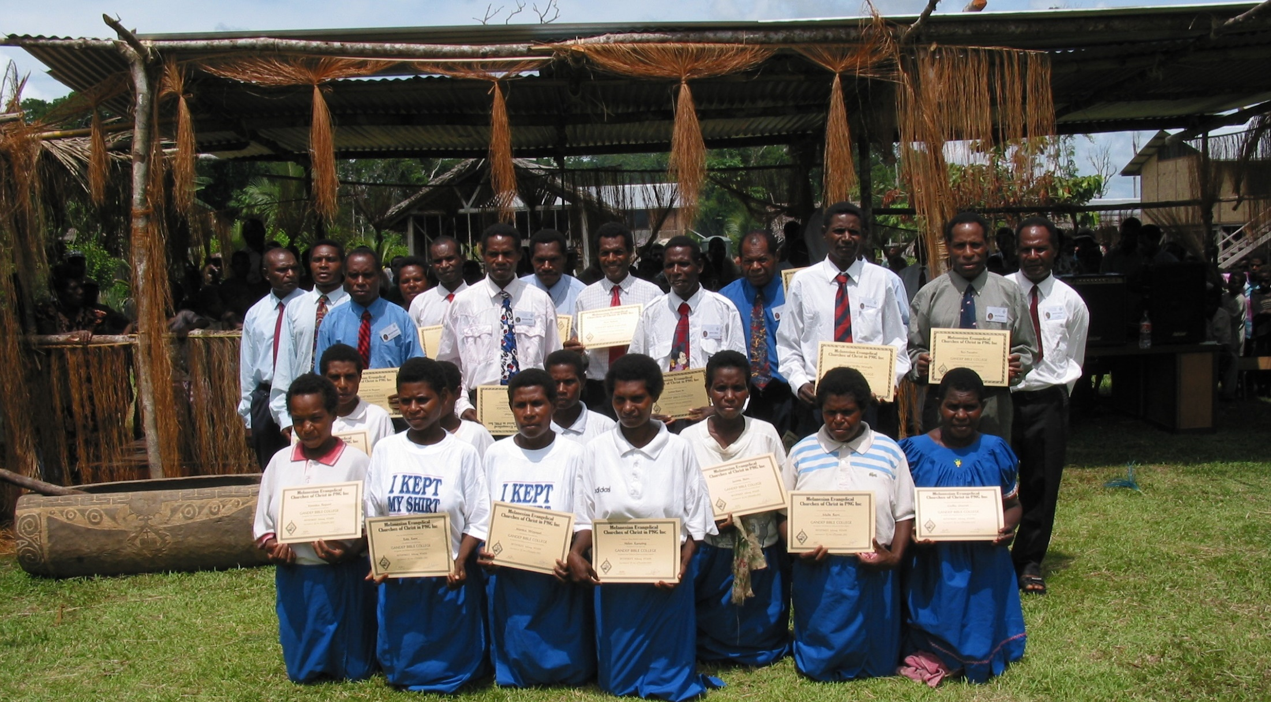
Gandep Graduating Students

Slide 28
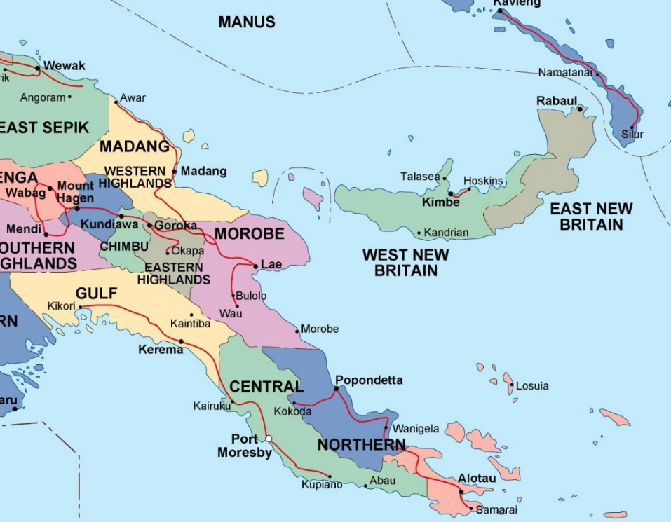
Papua New Guinea

Slide 29
South Sudan
51 baptisms in Jan-Feb 2020

Slide 30
Churches of Christ Overseas Aid
Clean Water – Nasawa, Vanuatu

Slide 31
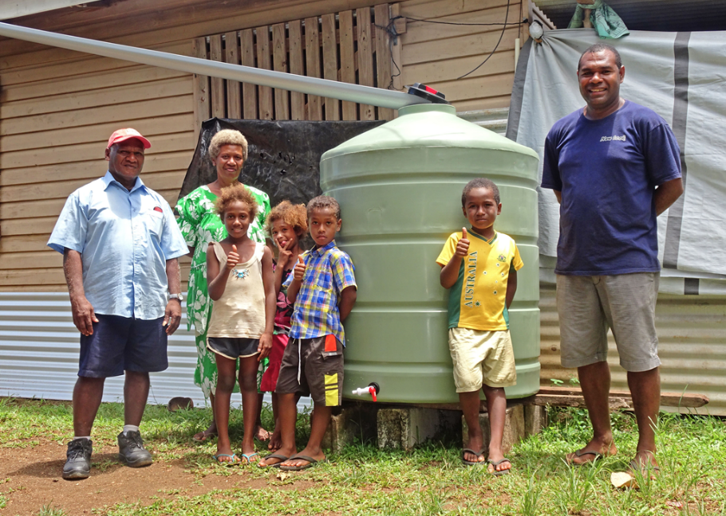

Slide 32
Community Survey

Slide 33
Lack of resources
Still ploughing by hand

Slide 34
Ox and Plough Project
Increases productivity

Slide 35
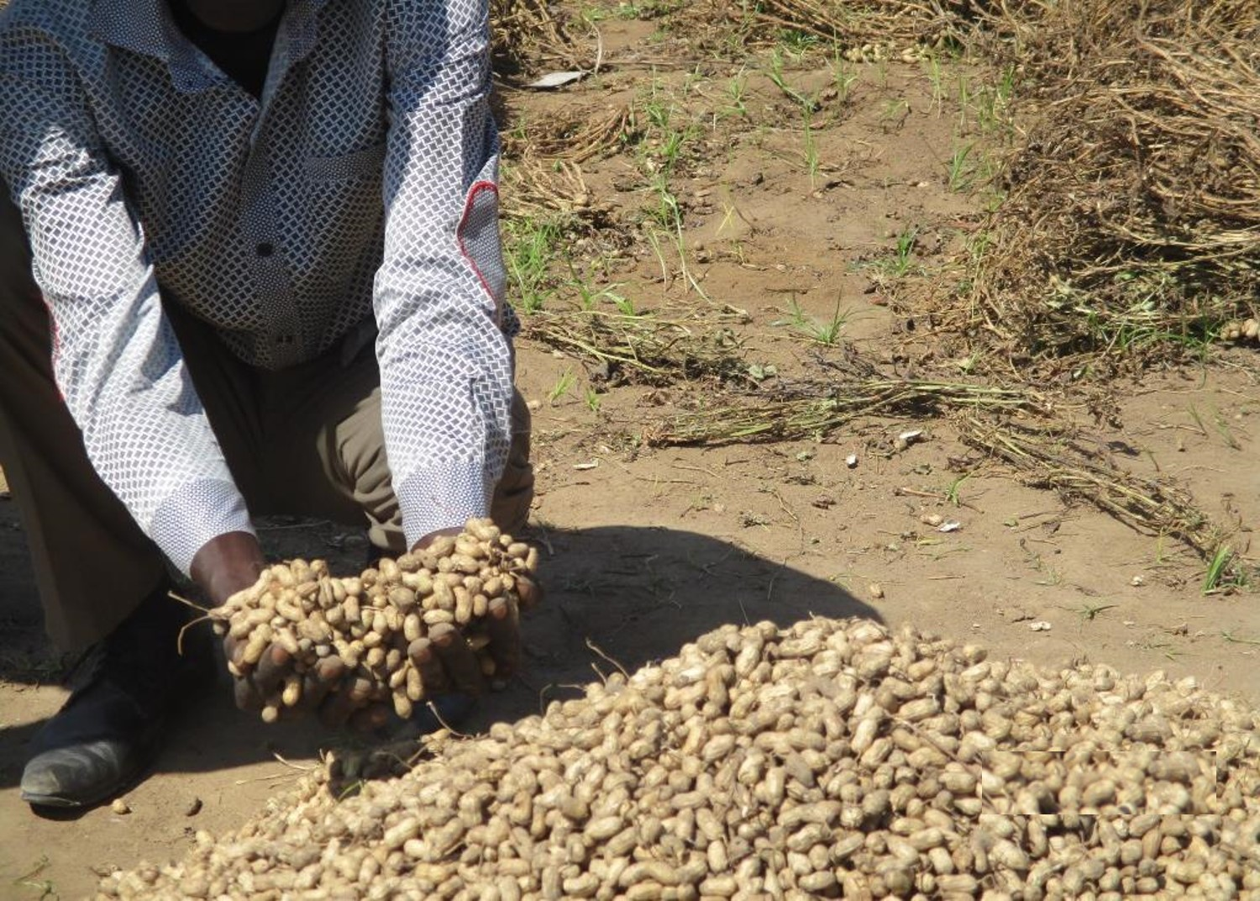
Increased crop yields
Up to 10 times the former harvest

Slide 36
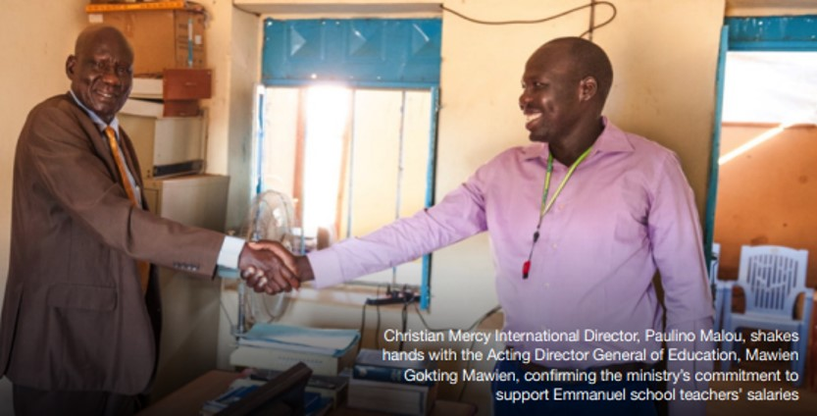
Government Partnership
Teachers Salaries promised in 2017 still hasn’t happened

Slide 37
Juba Church of Christ

Slide 38
LAFOSS Peace Clubs

Slide 39
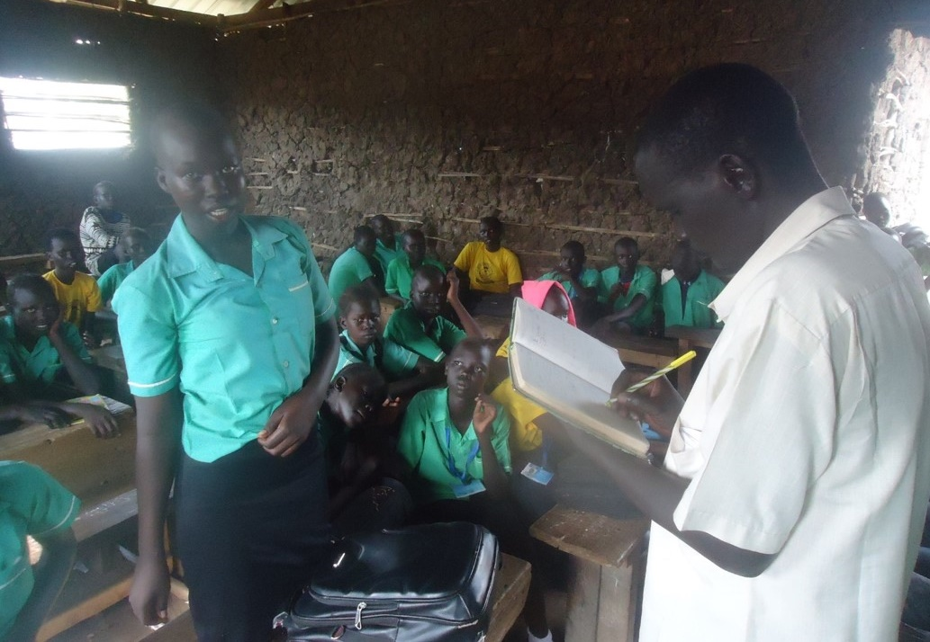
Peace Clubs in Schools, South Sudan

Slide 40
Indigenous Ministries Australia
Ps Greg Little, Bunbury, WA

Slide 41
Tia Tuckia, Ceduna
Tjilgamooda Church of Christ

Slide 42
2019 Water Tank
Tjilgamooda Church of Christ

Slide 43
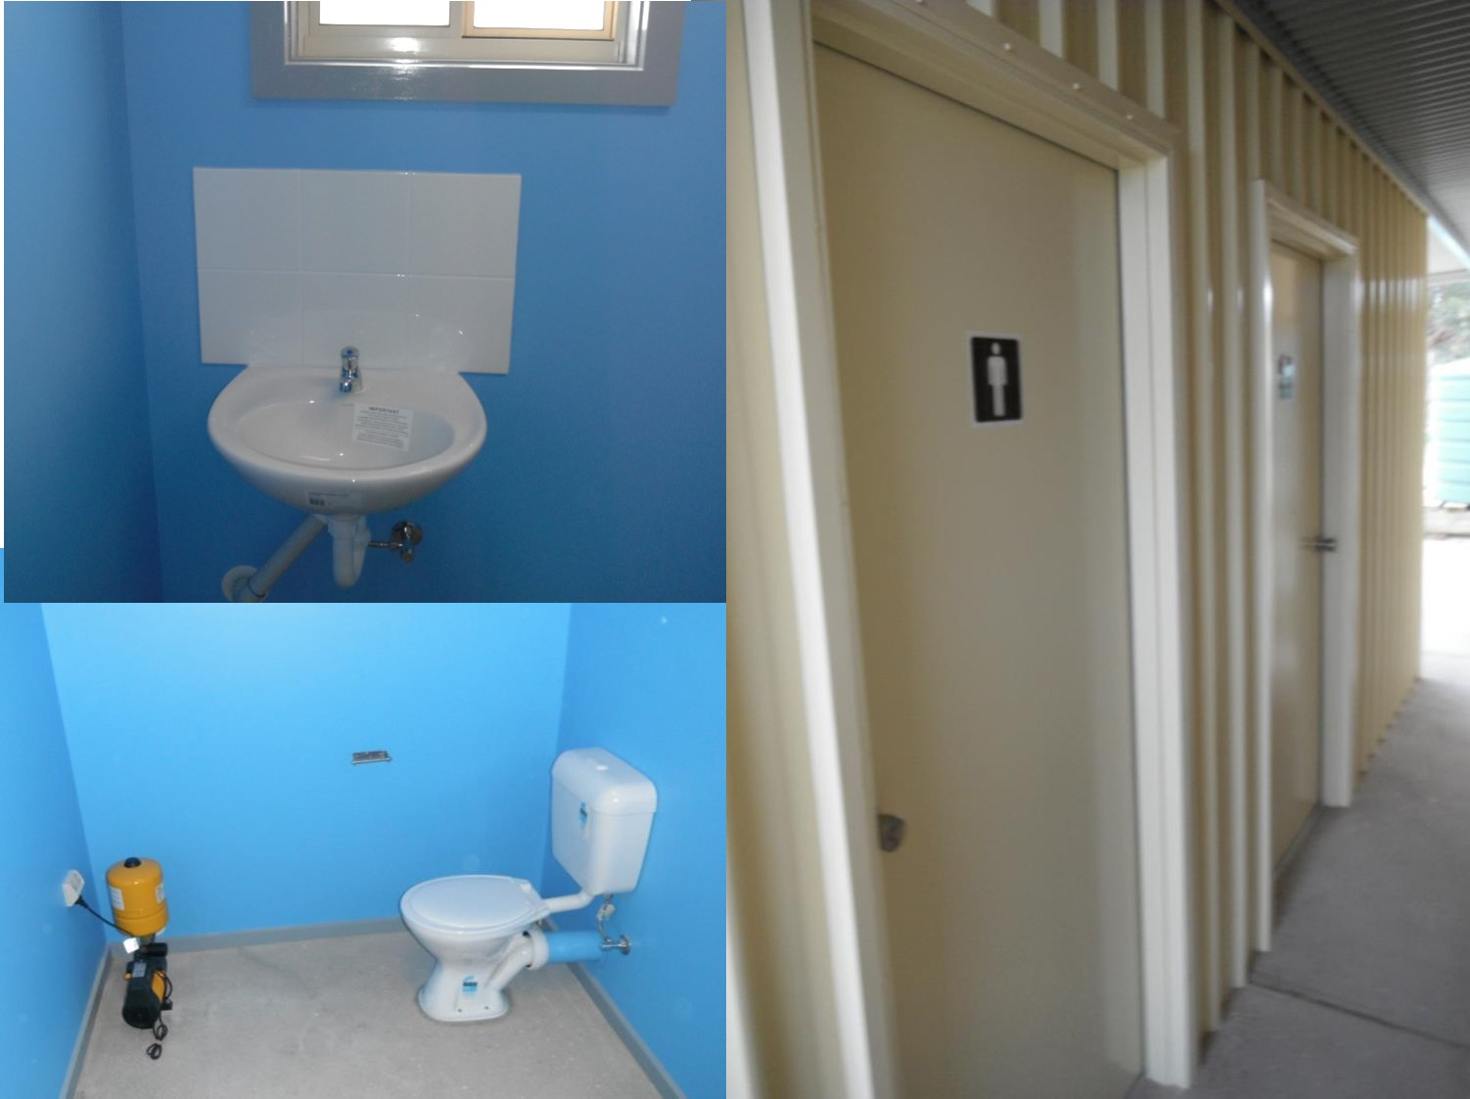
2019 Toilets
Tjilgamooda Church of Christ

Slide 44
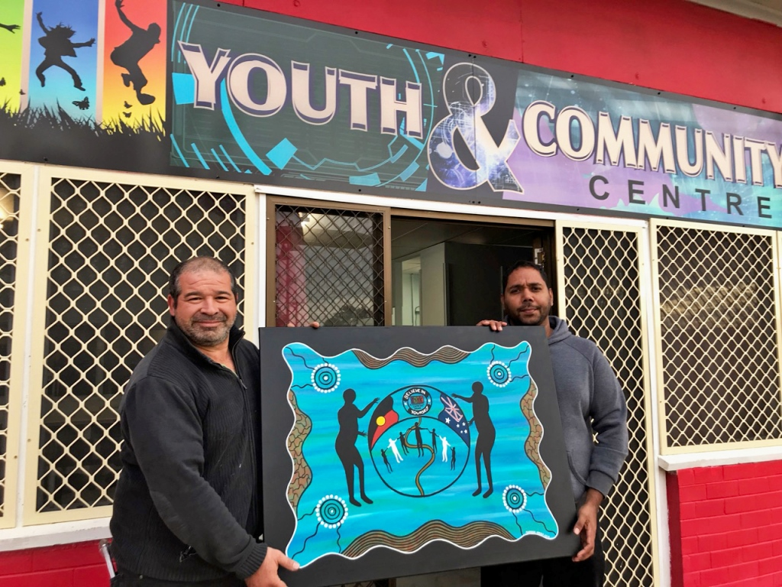
Dareton Youth and Community Centre
Ilker Deli, Manager, & Brendon Garlett, Chaplain

Slide 45
Whole variety of activities for Indigenous Youth

Slide 46
embody
National community of young people

Slide 47
Thank You for supporting the SWS Challenge!
One Month. Just Water. Raise Funds. Change Lives.

Slide 48
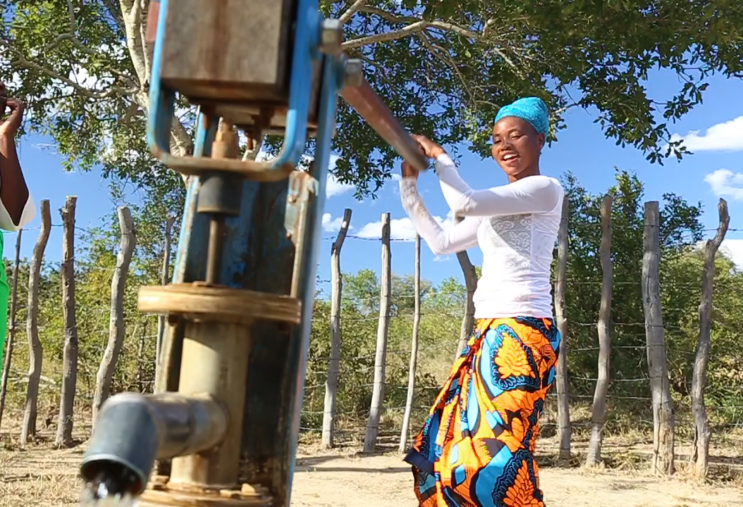
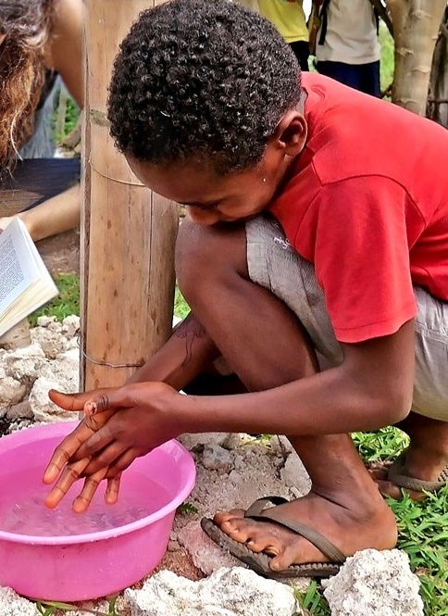
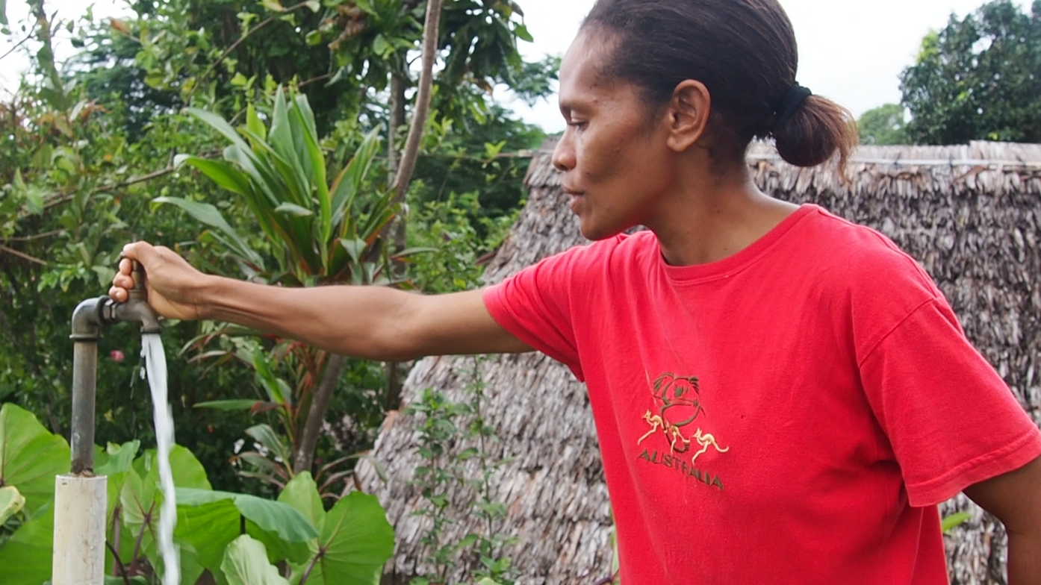

Slide 49
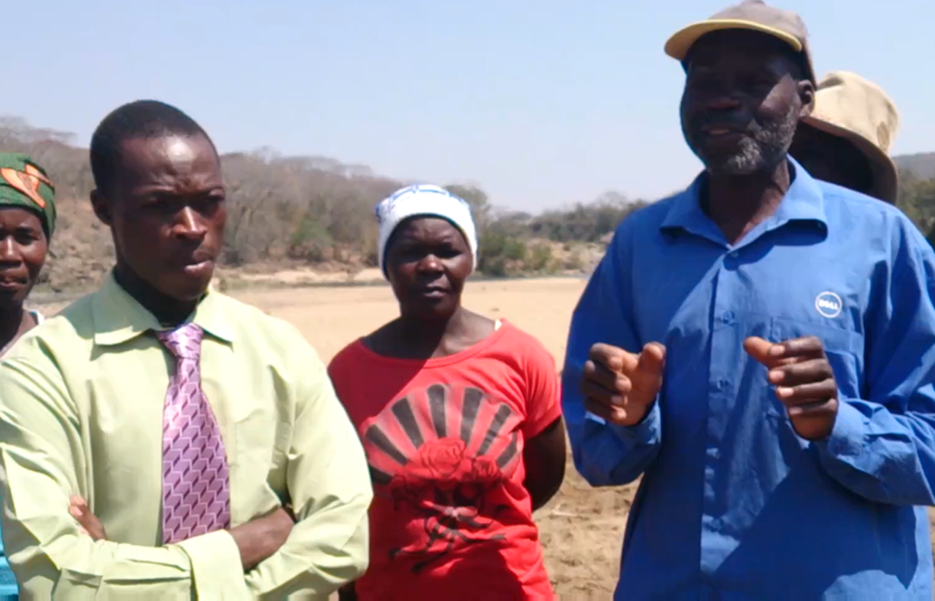
Above and Beyond Expectations
Rupemba Community, Zimbabwe

Slide 50
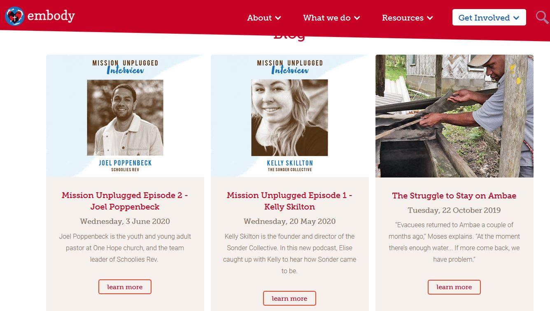
embody Blog / Discord
Check out www.embody.org.au

Slide 51
Fiona Briers, Bright Solutions Vietnam
Fiona and Huong at a local café stall
Check out www.brightsolutionsvietnam/products

Slide 53
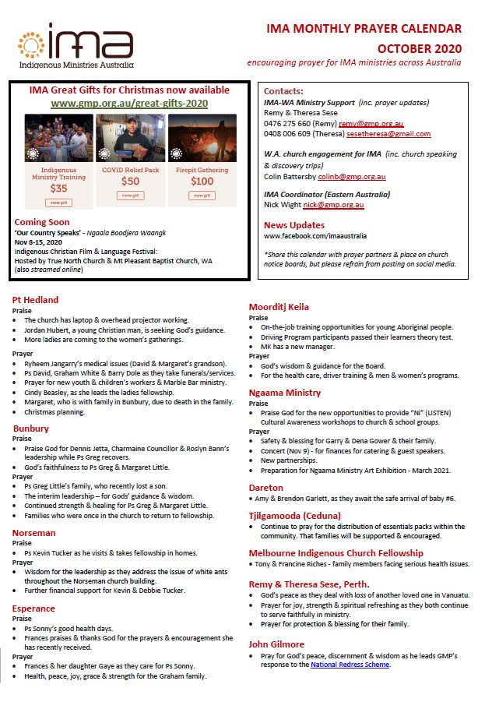
For more information: www.gmp.org.au

